Slide 1


Price and Probability: Decomposing the Takeover Effects of Anti-Takeover Provisions
Cuñat, Giné, and Guadalupe
Journal of Finance | 2020

Slide 2
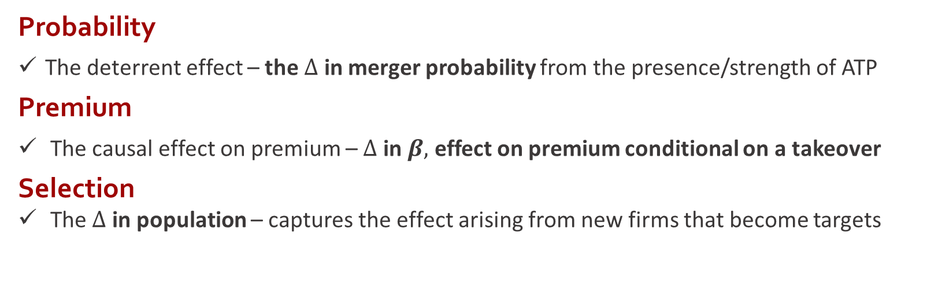
ATP Impact Shareholder Value?
WSU
Research Question
Authors show how much takeovers are deterred by ATP
Authors provide evidence that takeover premiums are lower among those protected
Probability
The deterrent effect – the $∆$ in merger probability from the presence/strength of ATP
Premium
The causal effect on premium – $∆$ in $β,$ effect on premium conditional on a takeover
Selection
The $∆$ in population – captures the effect arising from new firms that become targets

Slide 3
Two Specifications
WSU
Methodology
“We first need some form of ‘random assignment’ in the adoption of ATP”
Classic RDD
Can be extrapolated to firms with vote outcomes away from discontinuity (Angrist and Rokkanen, 2015)
A Matching Model (CIA)
Unless treatment is randomly assigned… right matching criteria or correlated omitted variables with assignment and outcomes?

Slide 4
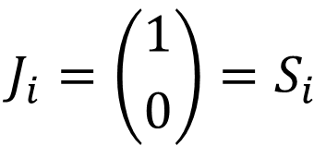
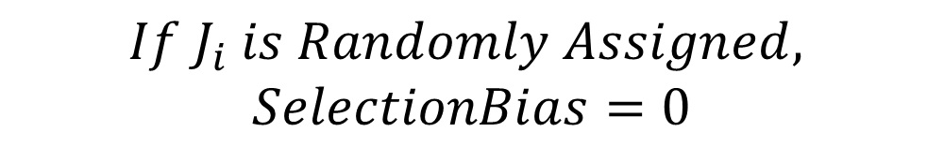
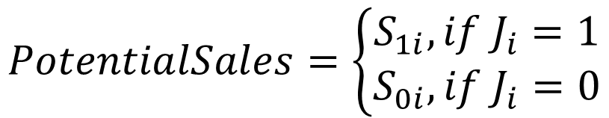

The CIA: A Sales Example
WSU
Identification Strategy
$$J_{i}=\left({1 \atop 0}\right)=S_{i}$$
$$∆μ=AverageCausalEffect+SelectionBias$$
$$>0 >0$$
$$PotentialSales=\left\{\begin{aligned}S_{1i}, if{ J}_{i}=1 \\ S_{0i}, if J_{i}=0\end{aligned}\right.$$
$$If{ J}_{i} is Randomly Assigned,$$
$$SelectionBias=0$$

Slide 5
Beyond RDD
WSU
Identification Strategy
“RD design takes the mystery out of treatment assignment.”
Classic RDD
In an arbitrarily small interval around the majority, assignment to either side can be considered random
To estimate this discrete change, one can use the entire data set
A Matching Model with Validated CIA
Classic RDD is local and comes from firms with vote outcomes around the discontinuity
To estimate a matching model, use a test that assumes all heterogeneity in the treatment comes from the running variable

Slide 6
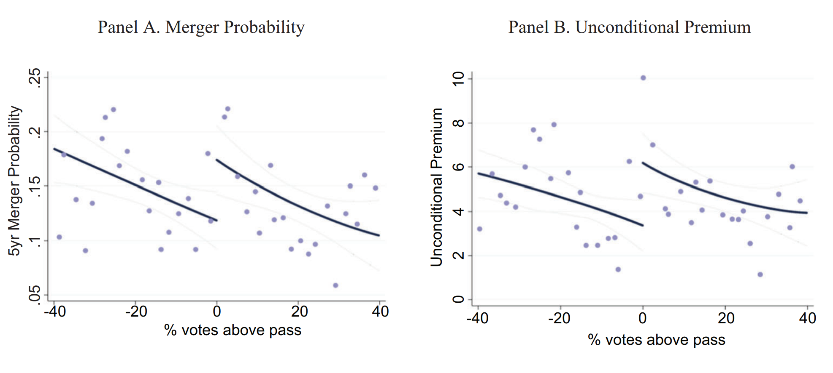
Results Using RDD
WSU
Results
“Unconditional Premium” is the total shareholder gain that includes both firms that experience a takeover (D=1) and those that do not (D=0)
Panel A shows the relationship between the merger probability and the distance from the majority threshold for Simple Vote Rule
The downward sloping line suggests that higher shareholder support for dropping ATPs is associated with a lower likelihood takeover (unobserved characteristics)
Panel B shows the same graph with the unconditional premium
Again, there is a clear negative relationship, but a positive change at the discontinuity (suggesting that voting to drop an ATP increases the unconditional premium that firms expect to receive

Slide 7
Results Using RDD
WSU
Results

Slide 8
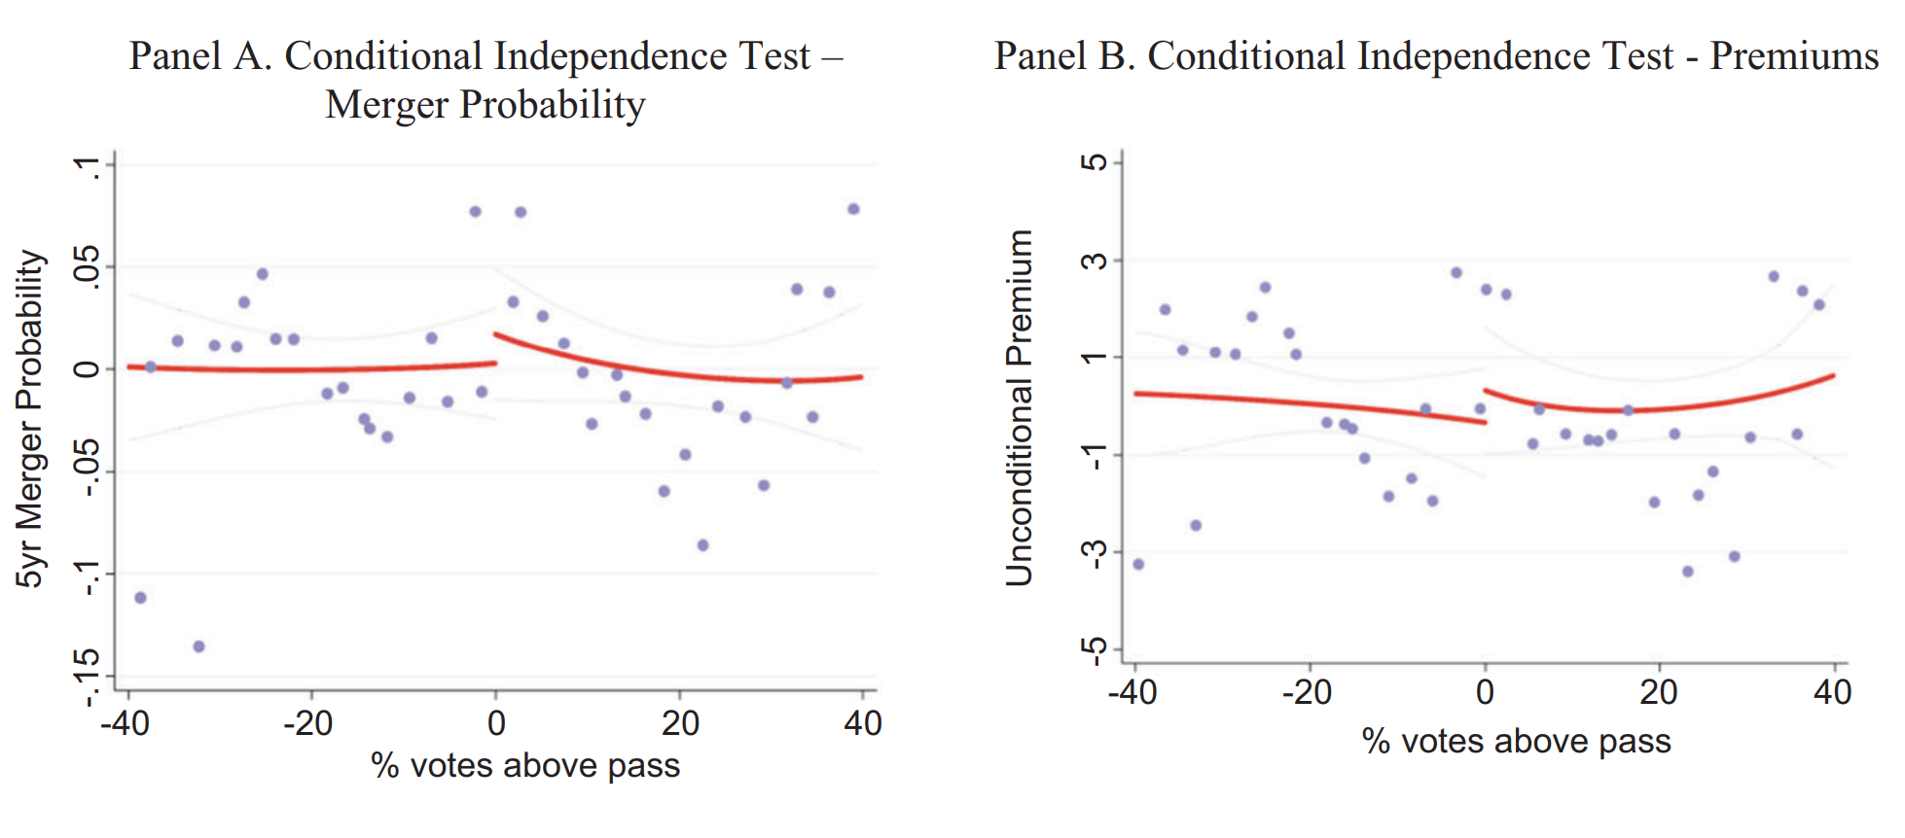
Conditional Independence
WSU
Results
Panel A
Plots takeover probability
Panel B
Plots unconditional premium
If the CIA holds after conditioning the model, the remaining relationship between firm outcomes and the vote outcome should be relatively flat
We see that the running variable is uncorrelated with potential outcomes along the vote support
The same is true for the adjusted vote support measure

Slide 9
Plausible Criticisms
WSU
Results

Slide 10
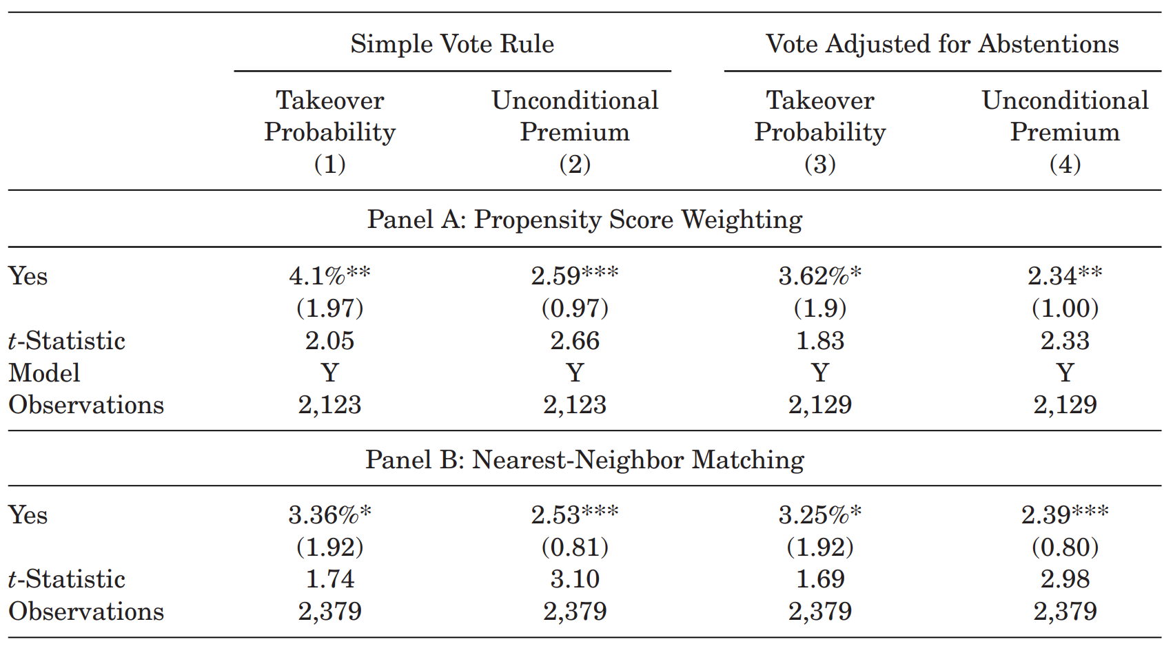
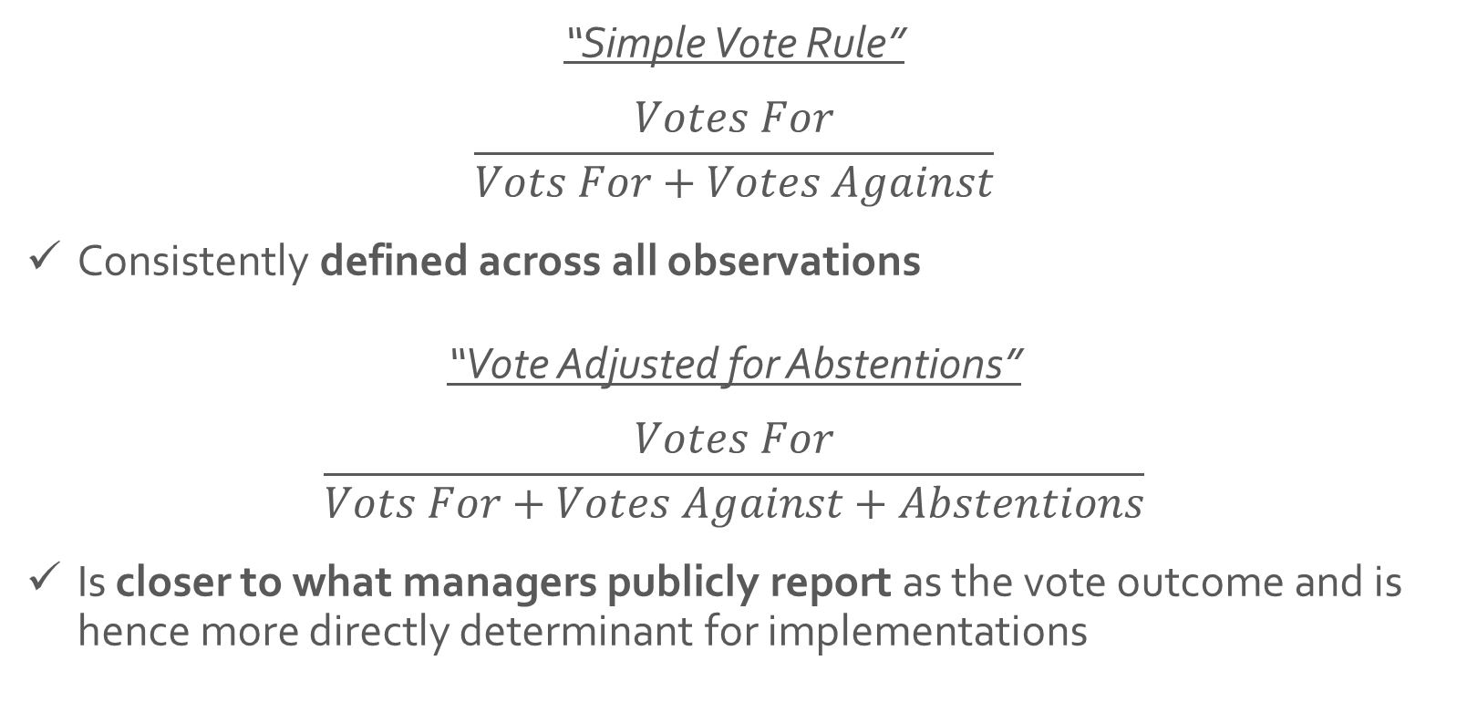
Table IV
WSU
Results
“Simple Vote Rule”
$$\frac{Votes For}{Vots For+Votes Against}$$
Consistently defined across all observations
“Vote Adjusted for Abstentions”
$$\frac{Votes For}{Vots For+Votes Against+Abstentions}$$
Is closer to what managers publicly report as the vote outcome and is hence more directly determinant for implementations

Slide 11
Table IV
WSU
Results

Slide 12



Conclusions
WSU
“In sum, we find no apparent trade-off between takeover price and probability – a trade-off typically presented by managers as rationale.”
Having an ATP in place reduces the likelihood of a takeover happening.
Deals that take place when a firm is protected by an ATP are ‘worse’.
Critique:
Authors treat all ATPs as if they were identical.
Results cannot be extrapolated – “we cannot rule out the possibility that firms in which the premium effect is negative never hold a vote on ATP.”

